Slide 1
Traffic Signs Detection and Recognition
Man Hok Hin

Slide 2
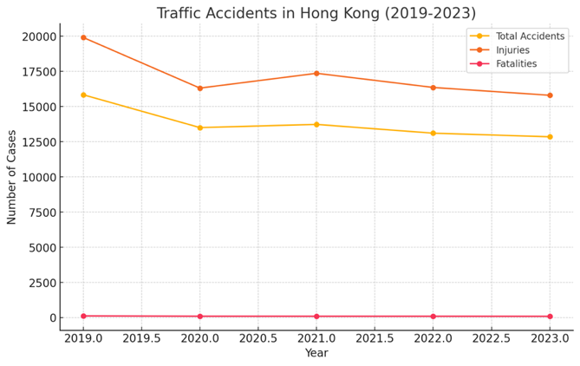
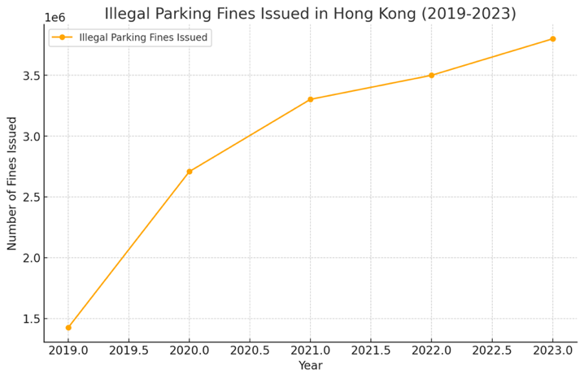
Introduction
Hong Kong Traffic Accidents between 2019 and 2023
Hong Kong Illegal Parking Fines Issued between 2019 and 2023
Ref: Number of Traffic Accidents with Person Injury (TAPI) by Police Region 2024,
Number of Traffic Enforcement by Quarter in 2024
Notes:
Let’s introduction some background, this slide shows two charts about traffic in Hong Kong from 2019 to 2023. The chart on the left shows the number of traffic accidents, injuries, and deaths during these years. The total number of accidents and injuries has gone down, while the number of deaths has stayed low and steady. The chart on the right shows the number of illegal parking fines given out. This number has gone up a lot, reaching over 3.5 million fines by 2023. This means illegal parking is becoming a bigger problem, and the police are giving out more fines. In summary, while traffic accidents are decreasing, illegal parking is increasing. So, we need to do an AI traffic sign detection system to improve the issues.

Slide 3
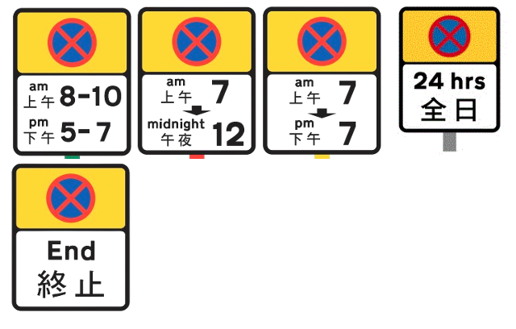
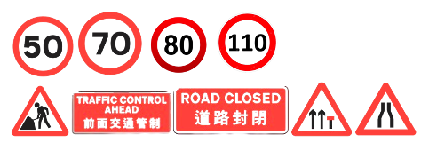
Problem
The drive doesn’t know where cannot parking
Real-time Detection of No parking Traffic Signs
The driver has not seen clearly that roadworks was in progress.
Real-time Detection of Traffic Signs
Recording Traffic Signs for Review
Instant Alerts for Drivers
Live GPS location
Car distance detection
Notes:
In case of this problem, first it maybe the driver doesn’t here can not parking. So, we should do real time detection of No parking traffic sign.
The second case is the driver has not seen clearly that roadworks was in progress.

Slide 4
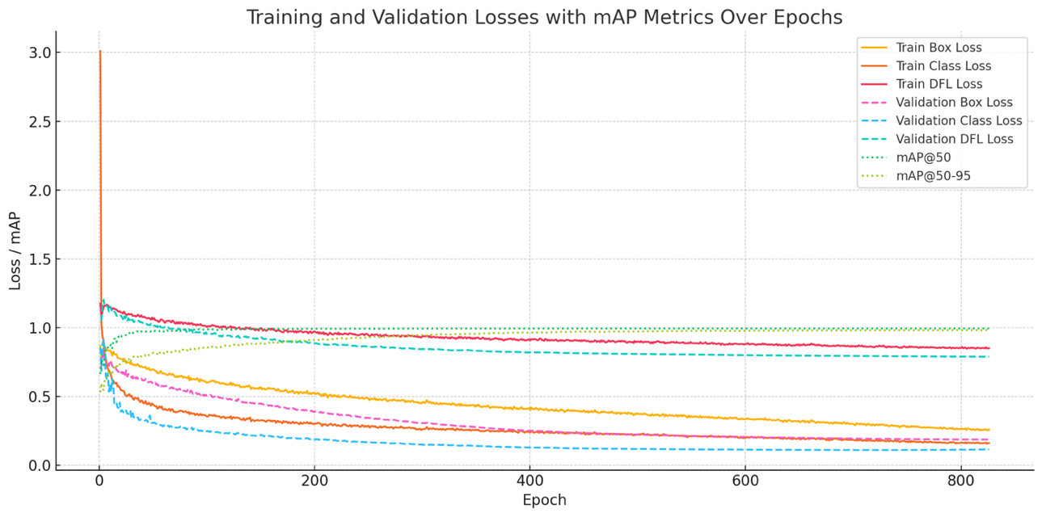
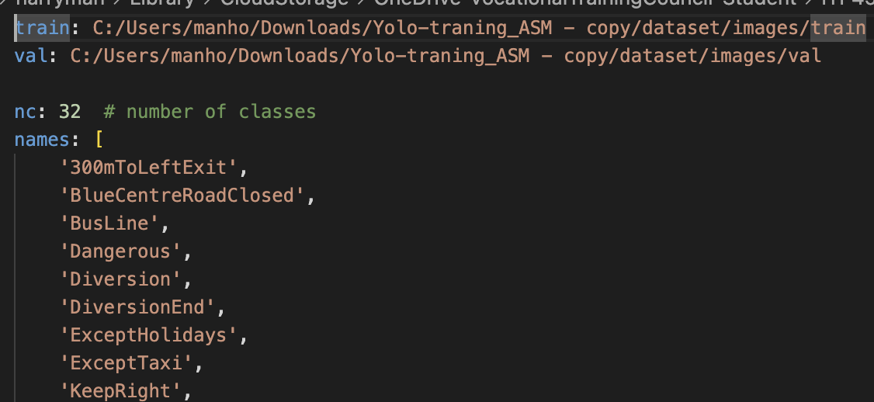
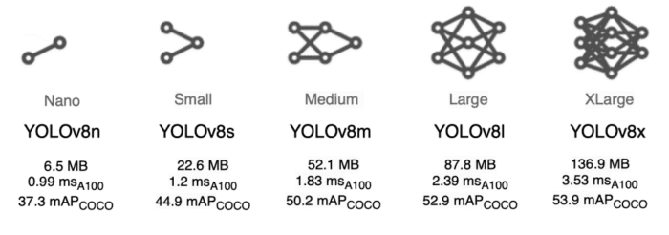
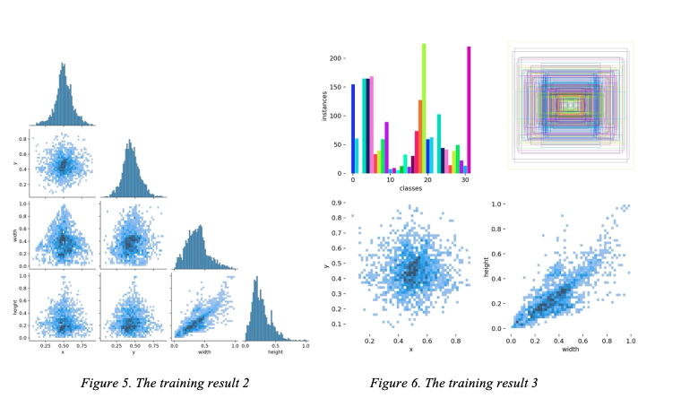
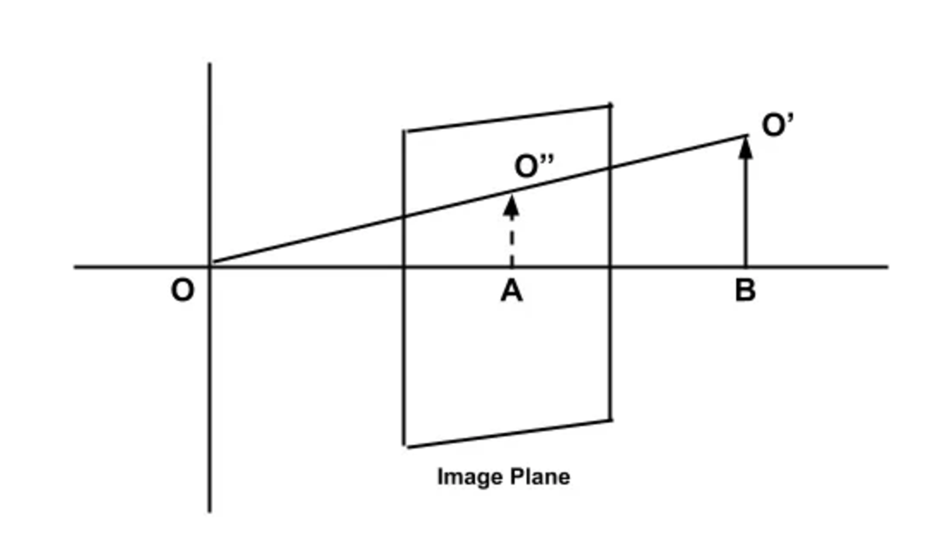
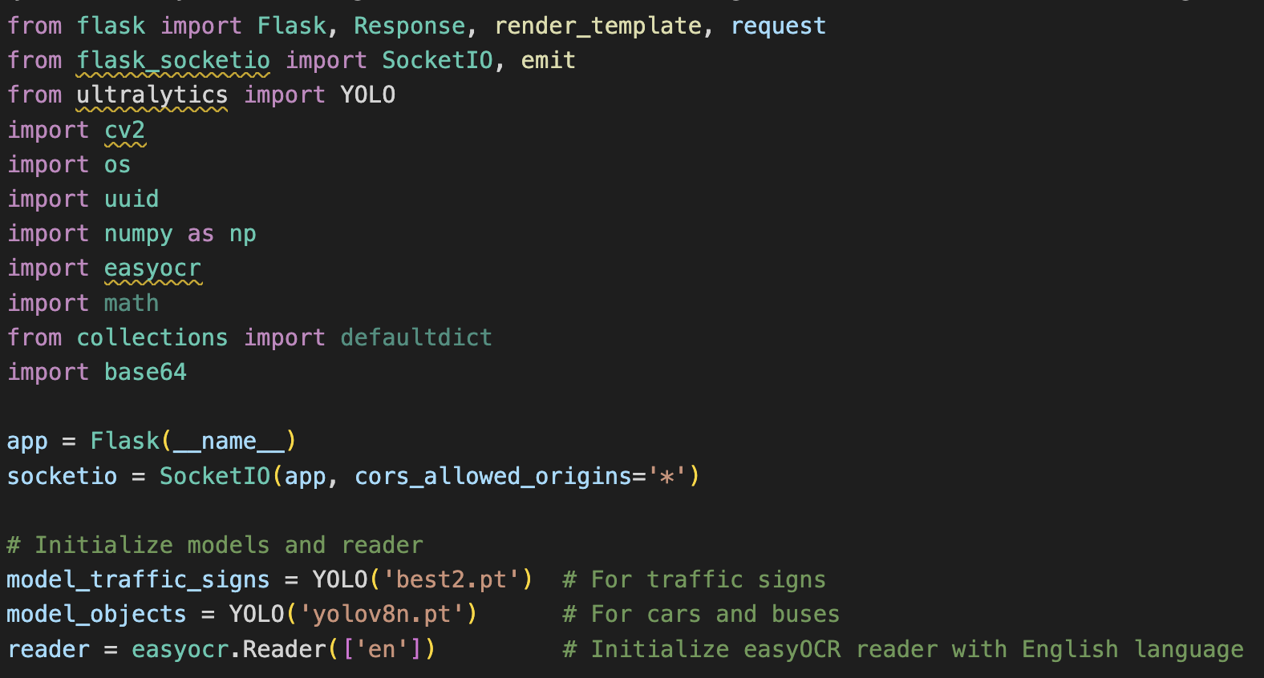
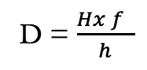
Methodology
Assume:
Car = 2m,Bus = 2.5m
Focal length=700
YOLO (You Only Look Once)
collected 2300 images to label and train the AI model
Using the Monocular Distance Estimation to calculate the font car distance
yolo train model=yolov8m.pt data=data.yaml epochs=1000 imgsz=640 batch=64 workers=4
D = $\frac{Hx f }{h}$
D = Distance to the object (meters or feet)
H = Car’s Actual height of the object (meters or feet)
f = Focal length of the camera (pixels or millimeters)
h = Apparent height of the object in the image (pixels)
Flash API Python Library
Holding the web server receive and send the request
Notes:
For the methodology, I use Yolo to training my ai model. I collected 2300 images to label and train it.
However, I was used the Monocular Distance Estimation to calculate the font car distance.
And then, I used the flash API library to holding the web server.

Slide 5
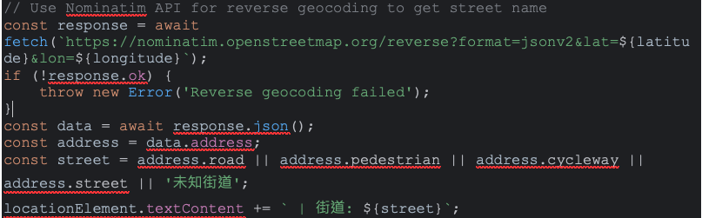
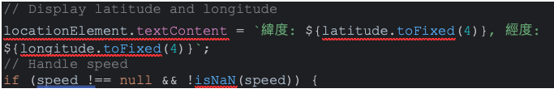
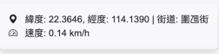
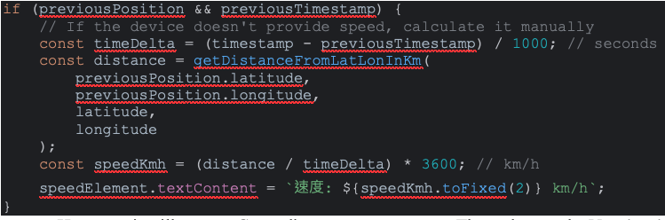
Methodology
SpeechSynthsis API – Provide real-time audio alerts to drivers
GPS Geo Location
Show the current location and street name
Calculate the speed
Notes:
In the front end, the SpeechSynthsis API is used for providing real-time audio alerts to drivers.
And the GPS Geo Location is used to show the current location and the street name.

Slide 6

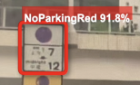
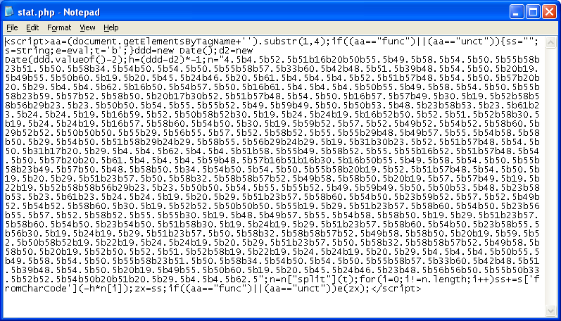
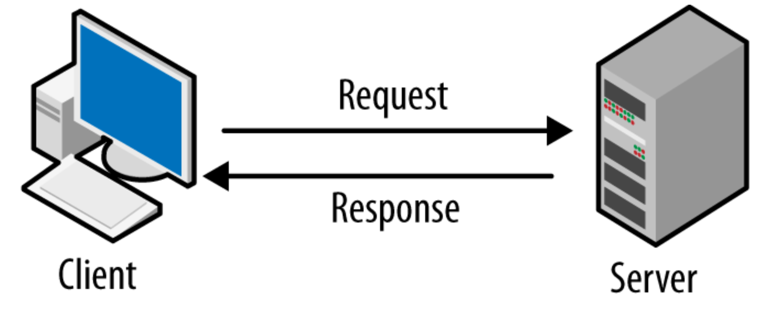
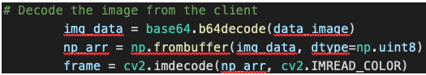
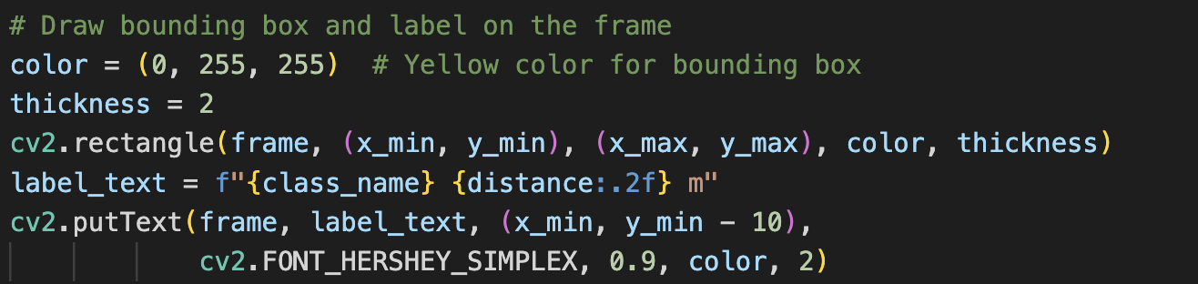
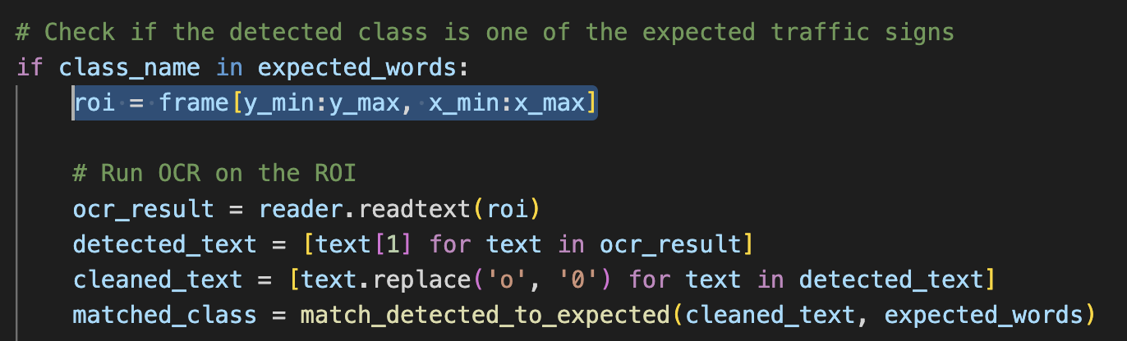
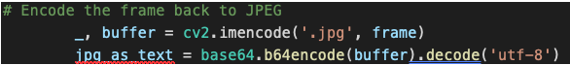
Methodology
New image
OpenCV Python Library
Convert this encoded data back into an image format (frame) that can be processed
Draw bounding boxes and labels on detected objects after detecting objects. Such as the traffic sign, car and bus.
Slicing the extract a portion of the frame containing the detected sign to do the OCR (if need)
Encoding the annotated frame back to JPG. The encoded image is then converted into base64 text to be transmitted over the WebSocket connection.

Slide 7
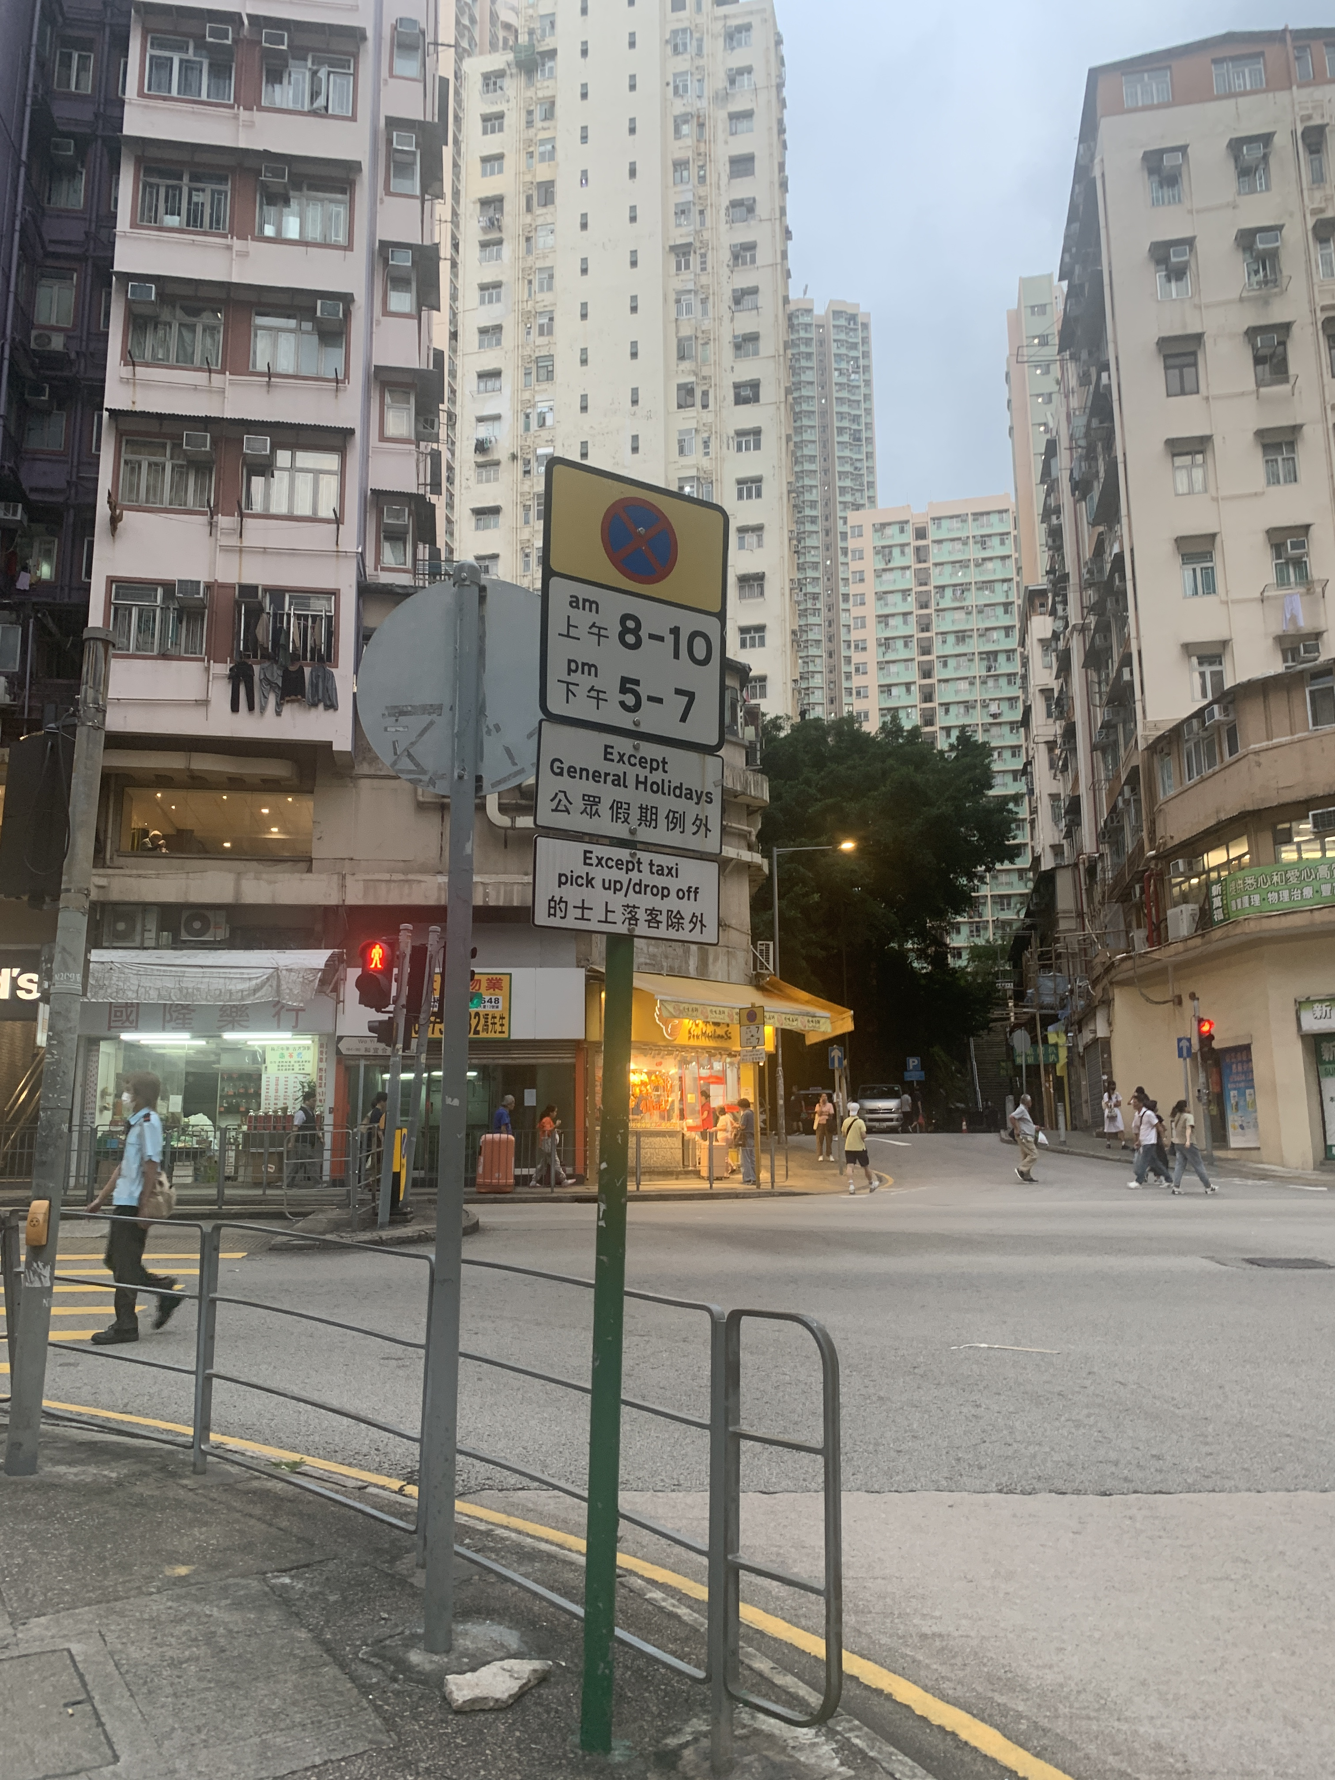
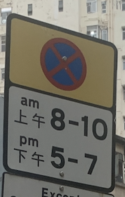
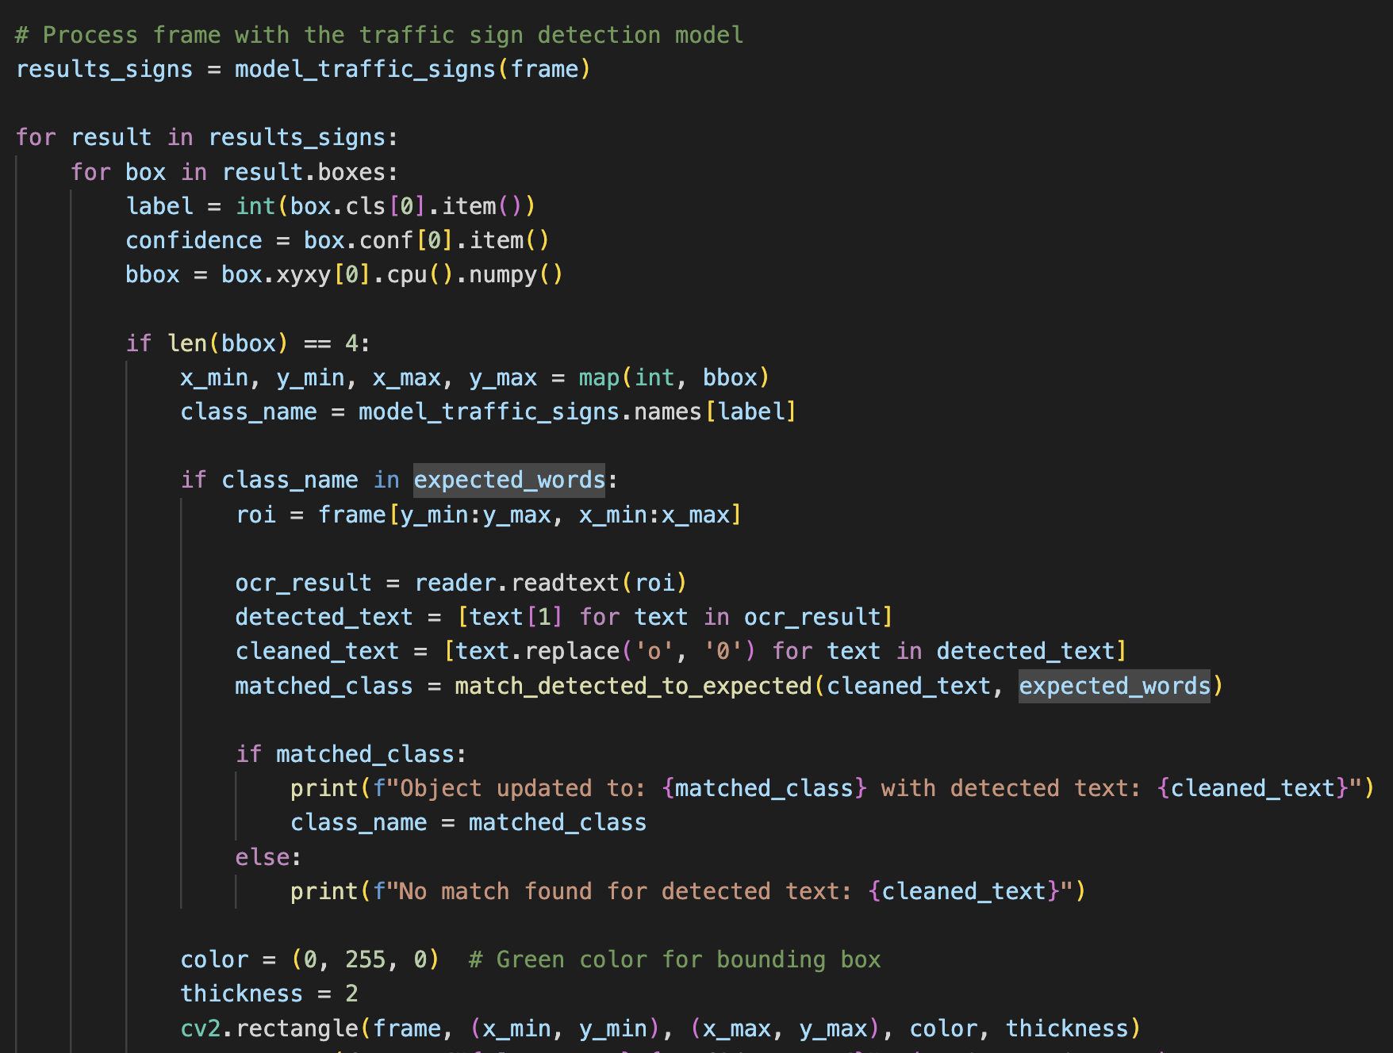
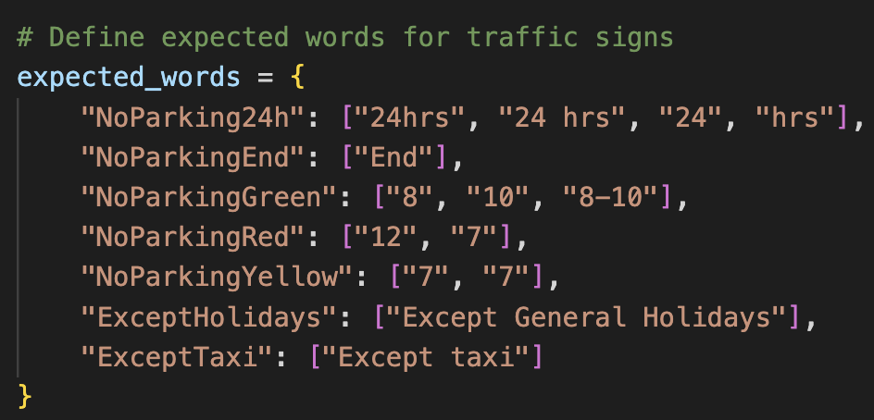
Methodology
EasyOCR Python Library
The EasyOCR is used to recognize text from detected no stopping traffic signs.
Initialization of the EasyOCR Reader to ‘en’
Extracting the region of interest (Partial slice of no parking traffic sign).
Use EasyOCR to detect text
Post-processing and matching with expected words as the “no-stopping” traffic sign is very similar

Slide 8
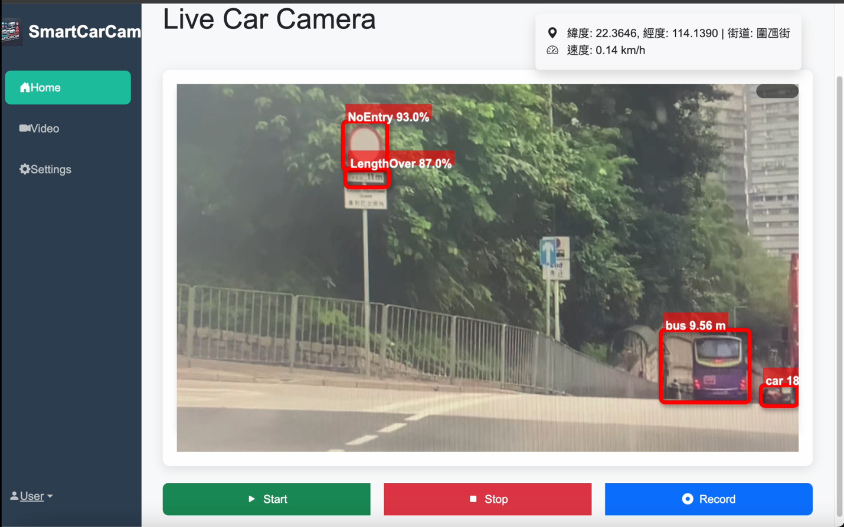
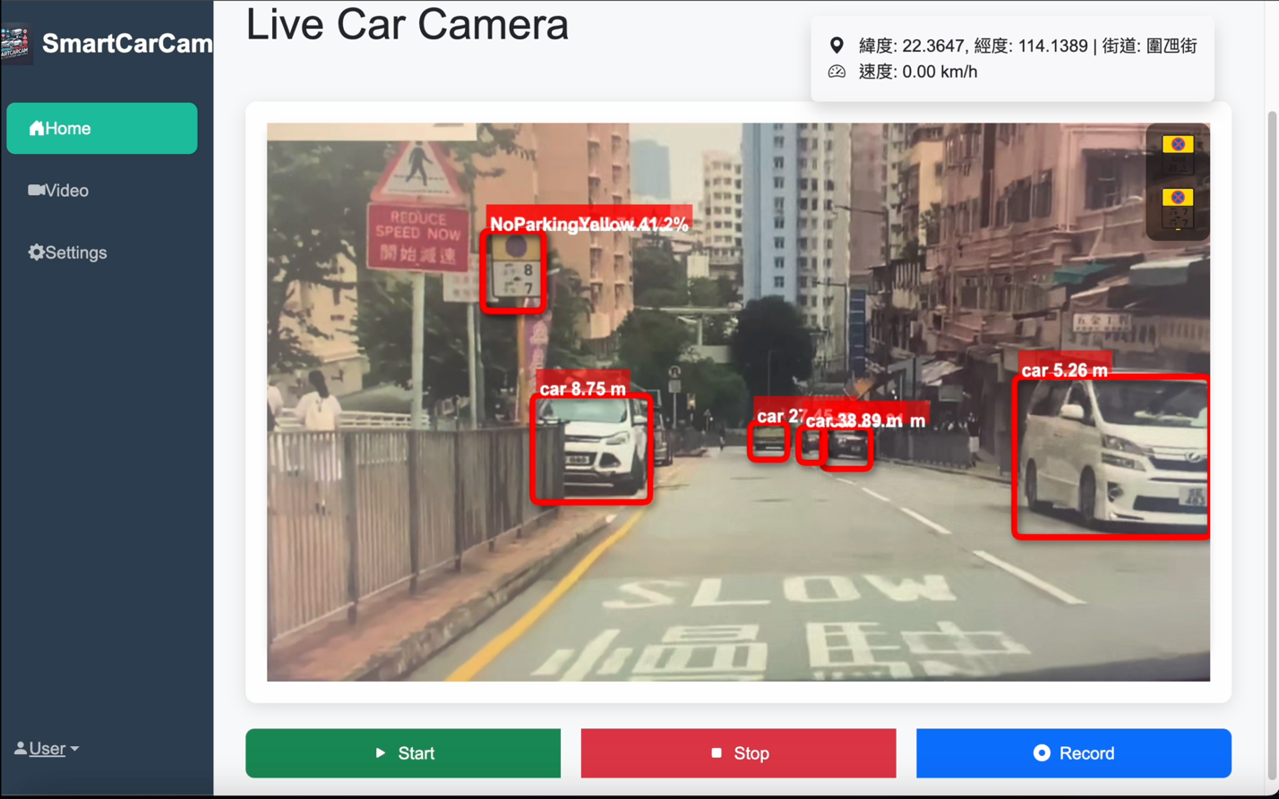
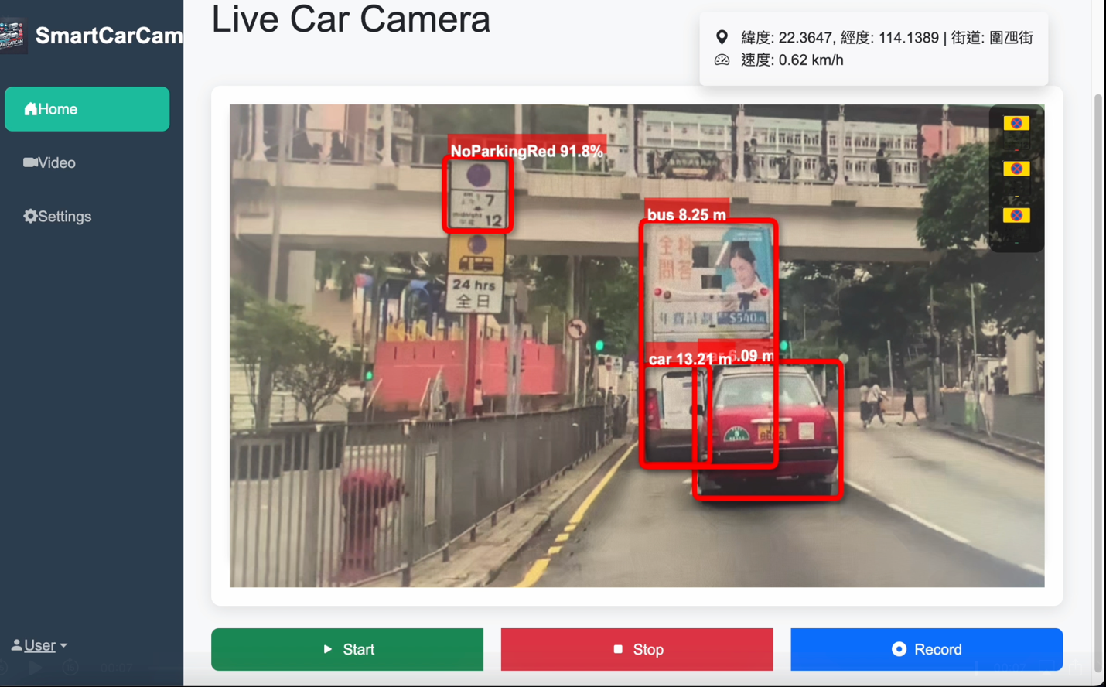
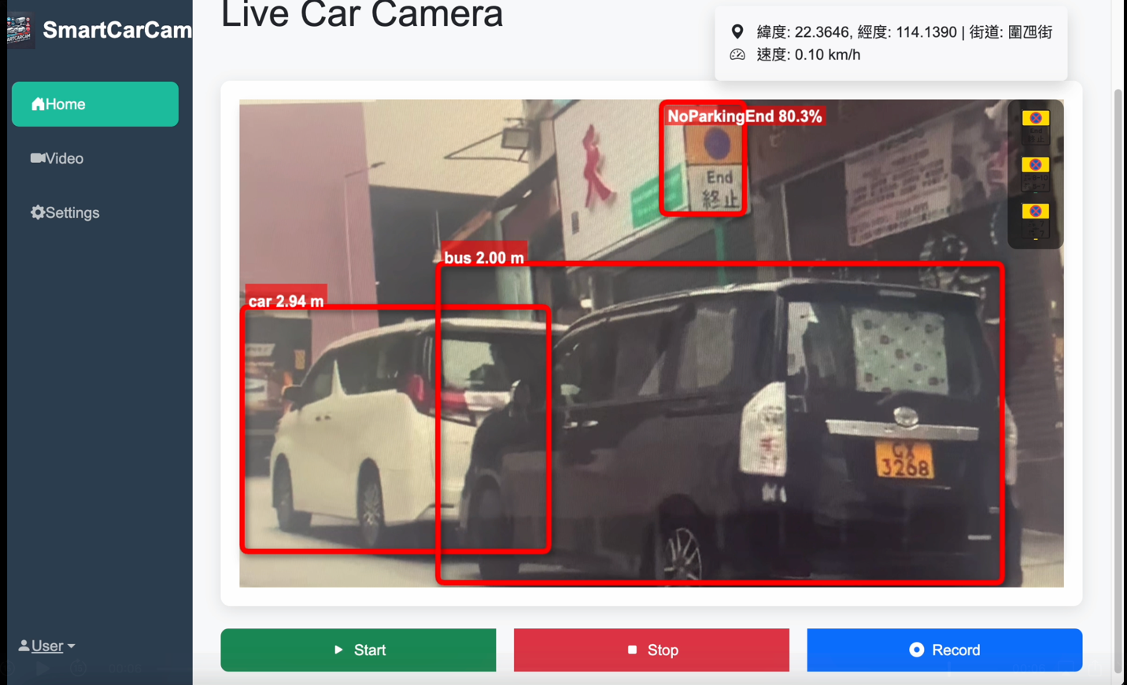
Findings & Results
Detect different no stopping traffic sign
No entry of longer than 11m’s car
Alert the truck driver can not go there

Slide 9

Findings & Results

Slide 10
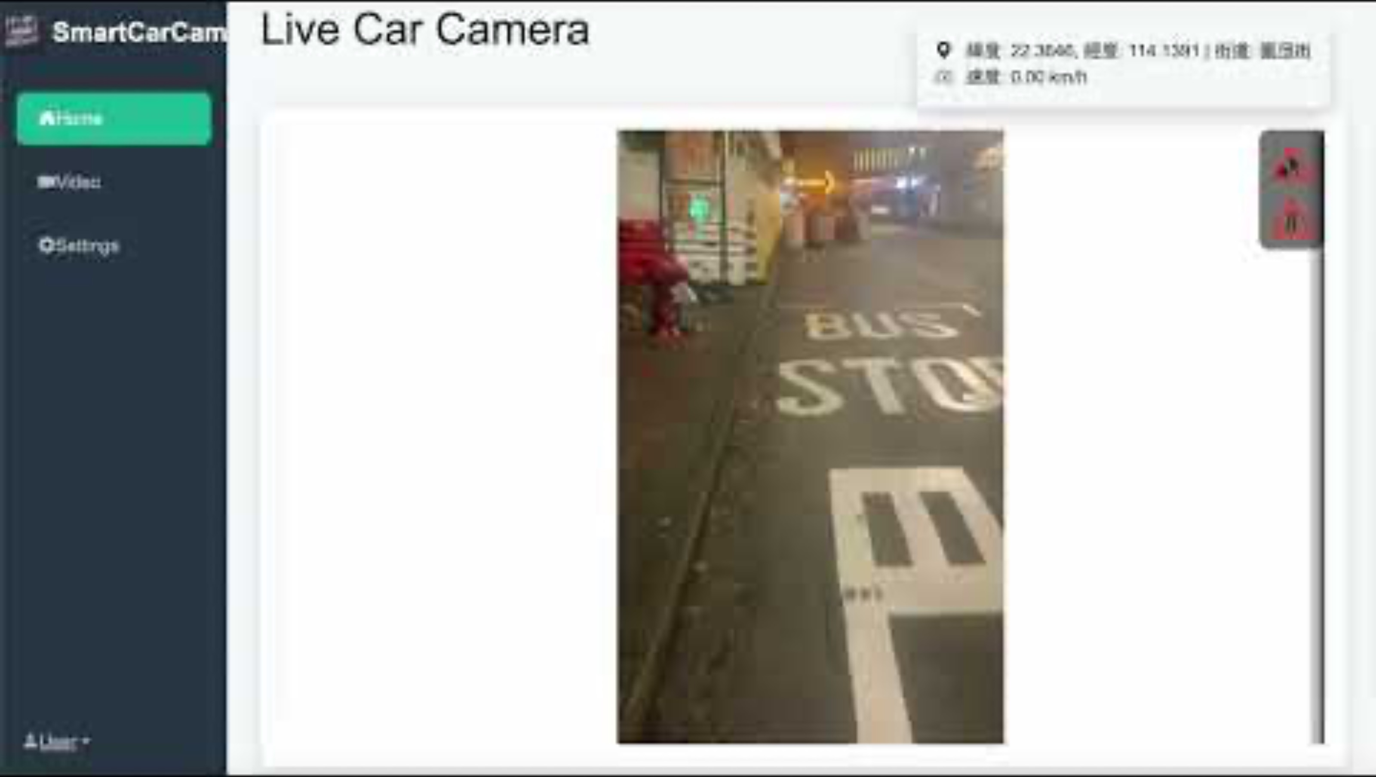
Findings & Results

Slide 11
Improvement
Add more traffic sign which can be identify
Improve the OCR function
Add more data to train model to improve accuracy
Add Train more data in bad weather
e.g. Heavy Rain, Heavy Fog …

